Slide 1

Underground water Analysis

Slide 2
About us
Sushma Valloju(B.Tech)
Sriketh Siripuram (B.Tech)

Slide 3
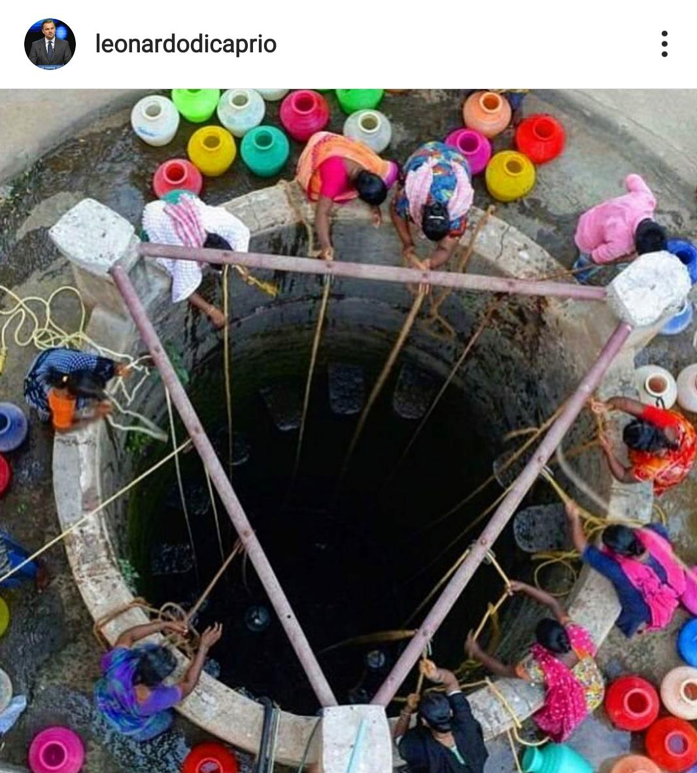

Problem Statement
Water resources are sources of – usually fresh – water that are useful, or potentially useful to society; for instance for agricultural, industrial or recreational use.
Virtually all of these human uses require fresh water.
Notes:
The post of dicaprio were inspired us to choose this topic and (say points on slide)

Slide 4
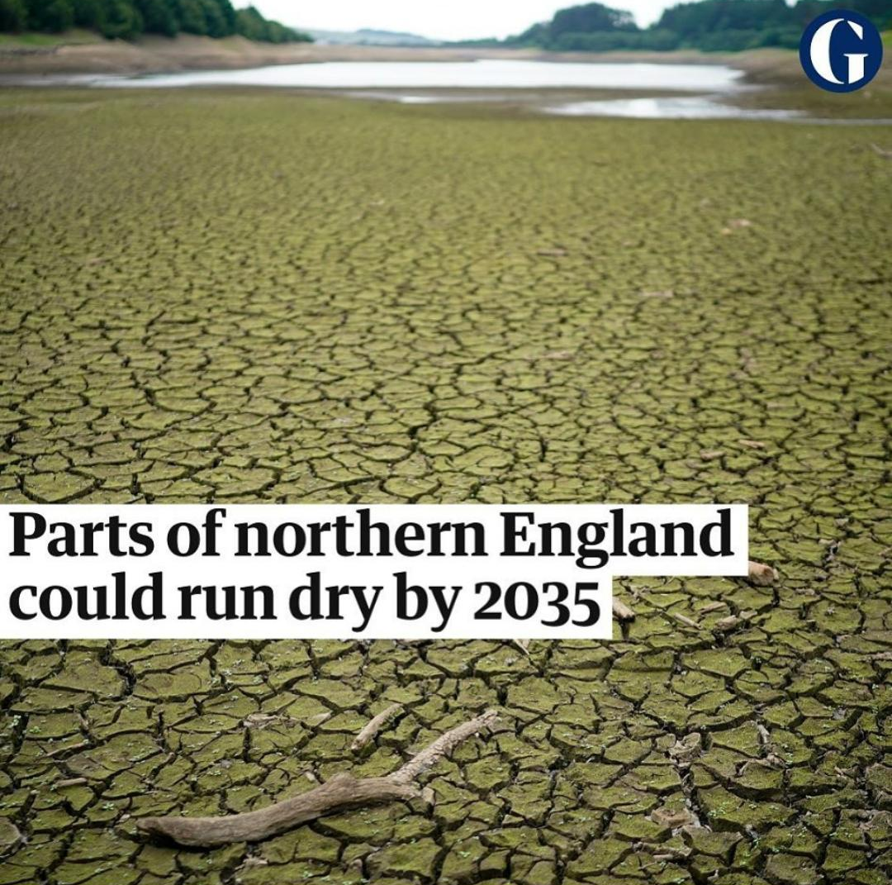
Problem Statement
Only 2.5% of water on the Earth is fresh water, and over two thirds of this is frozen in glaciers and polar ice caps.
Water demand already exceeds supply in many parts of the world, and many more areas are expected to experience this imbalance in the near future.
Notes:
(Starts with first points on the slide )and (for second point) the water wastage were increasing and the water demand also increasing .the water wastage is exceeds than supply.

Slide 5

Our Agenda :
Analysis of Wastage of Water
Top five Countries in terms of Total withdrawal
Top five Countries in terms of Usage of Water
Top five Countries in terms of Domestic ,Industrial , Agricultural withdrawals
Top five Countries in terms of Wastage of Water
Analysis of Countries in terms of most using Domain

Slide 6
Requirements:
Python
Beautiful Soup (To Parse HTML response in to bs4 tags)
Pandas (EDA)
Numpy (Arithmetic Operations on Data Frame & Series)
Matplotlib (Visualization)
Seaborn (Visualization)
Requests (To get HTTP response body of the URL)
xlsxwriter (Engine to write and read from Excel Sheet)

Slide 7
The Process
Interpret
Analyzed the result
5
Data visualization
Constructed models to predict and forecast .
4
Data Cleaning
Fixed the missing values and inconsistencies in the Data .
3
Data Preprocess
Scrapped the data as per required for the project.
2
Data Collection
Gathered the Raw Data from the Wikipedia source
1
Notes:
Data preprocess: In this we scrapped the data as per reuired for the project by we added the columns like(name of the columns)
Date Cleaning: fixing the Nan values we preferred to remove the Nan Value rows because one country water resource cannot find by the mean of other countries
Remaining as in the slides

Slide 8
Data Scraping
Load the HTML response from the URL of Wikipedia into BeautifulSoup
Converted the unstructured data into the structured data
All elements were combined into the Pandas Dataframe
And that Dataset is used for the visualization

Slide 9
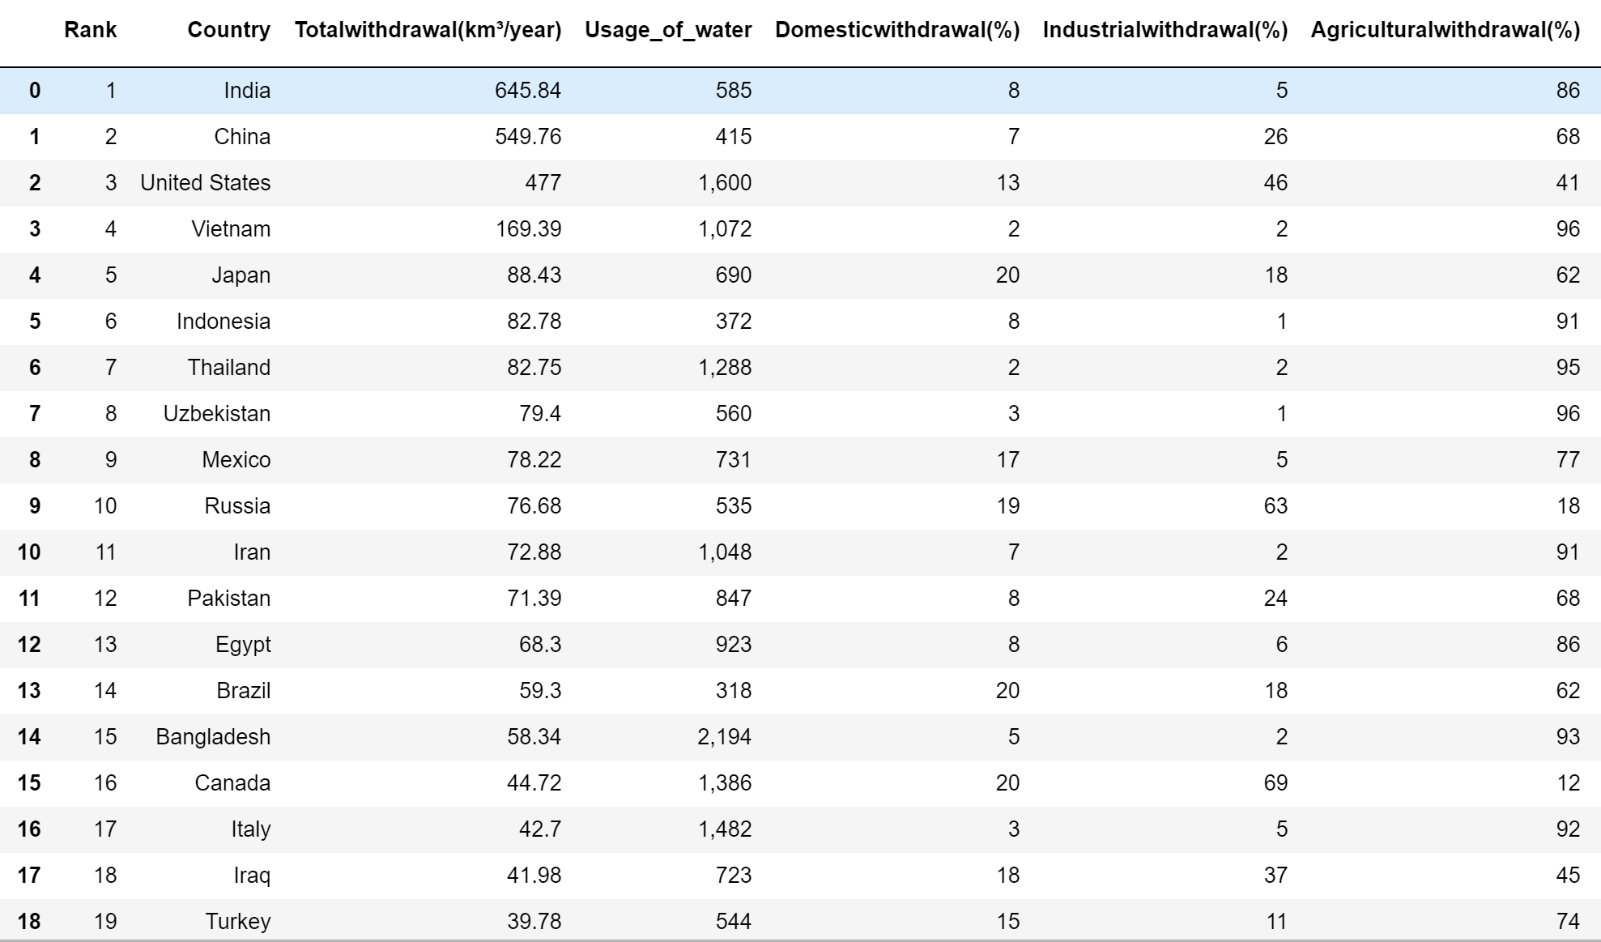
Dataset after the Scraping

Slide 10
The Features
The shape of the DataSet was is (170,6). From that DataSet we removed the NaN values data by dropping all the NaN values.
We added the new attributes in our Dataset by using the Data we got .
We had updated our dataset by adding the new column called most_used,by finding the most used category of the each each country

Slide 11
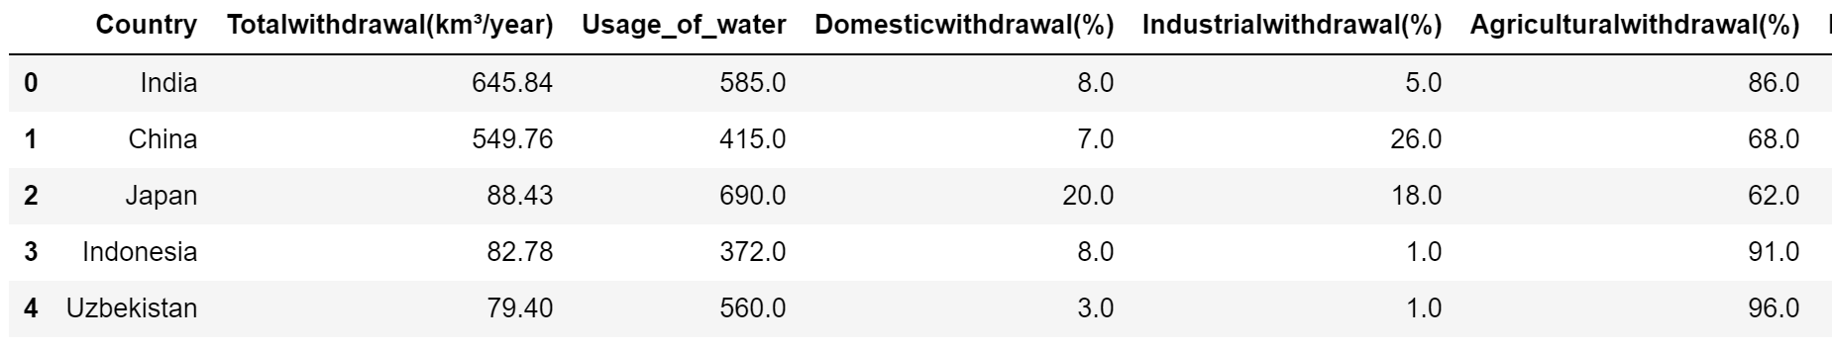
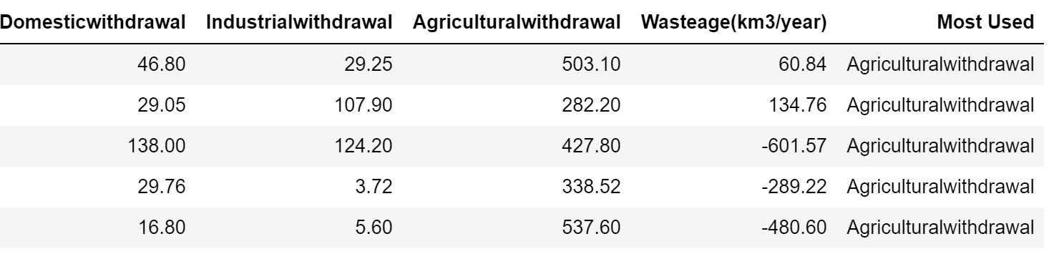
The Final DataSet
…...
….
.
.

Slide 12
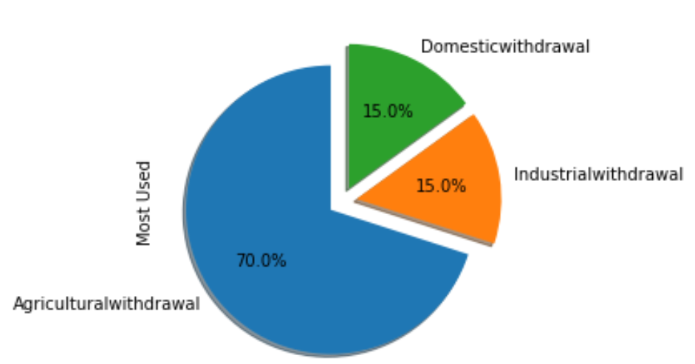
The Most Used analysis
The most of the countries withdrawal the water for the Agricultural usage
It is estimated that 70% of world-wide water used for irrigation in agriculture.
And the remaining 30% is equally distributed between the domestic and industries

Slide 13
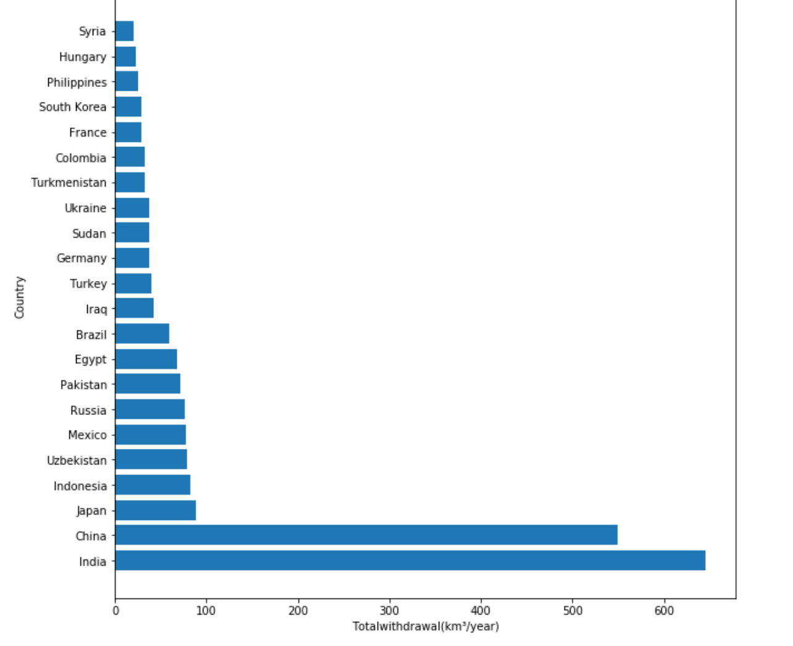
Total withdrawal Analysis
The top 5 countries in term of more amount of groundwater are
India
China
Japan
Indonesia
Uzbekistan

Slide 14
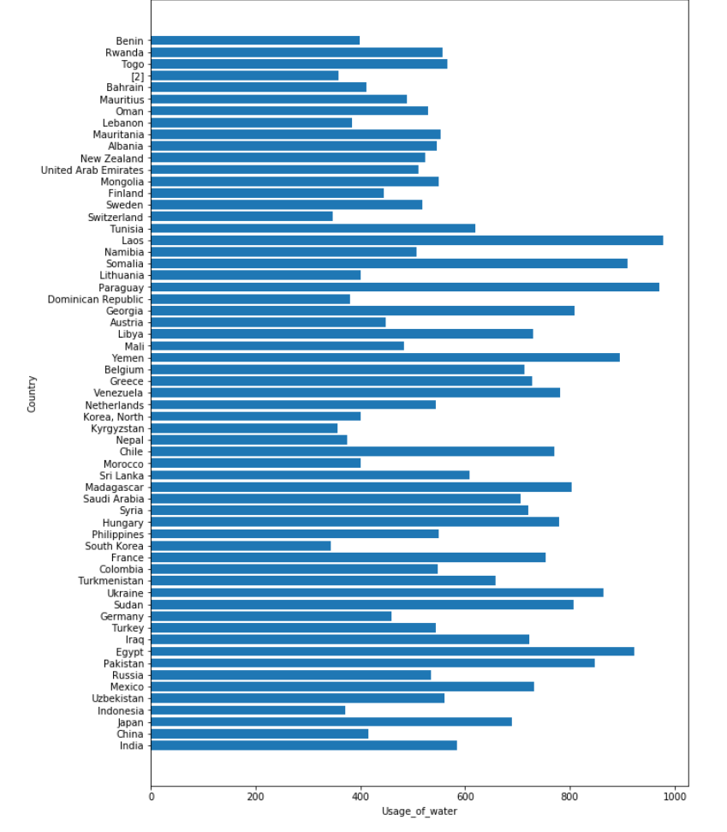
Total Usage of Water analysis
The top 5 countries in term of usage of water are
Laos
Paraguay
Egypt
Somalia
Yemen

Slide 15
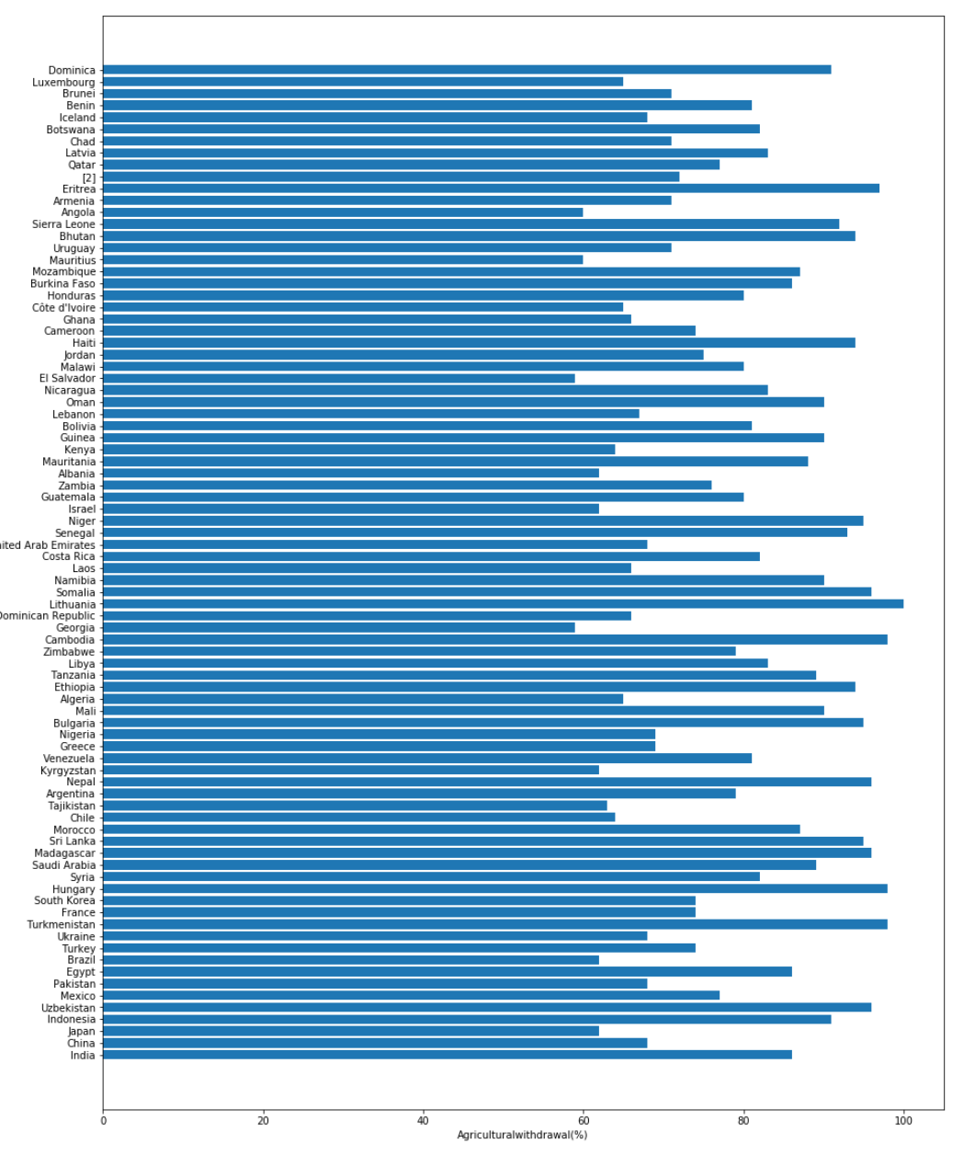
Agricultural withdrawals Analysis
The top 5 countries in term of Agricultural withdrawals of water are
Somalia
Egypt
Madagascar
Hungary
Turkmenistan

Slide 16
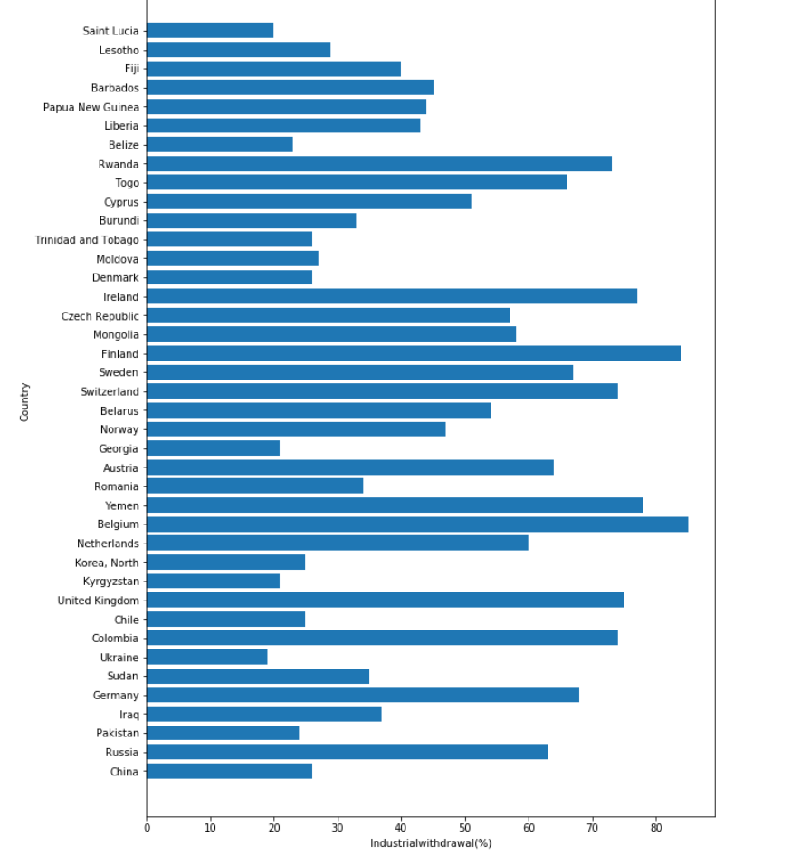
Industrial withdrawals Analysis
The top 5 countries in term of Industrial withdrawals of water are
Yemen
Belgium
Rwanda
Colombia
Togo

Slide 17
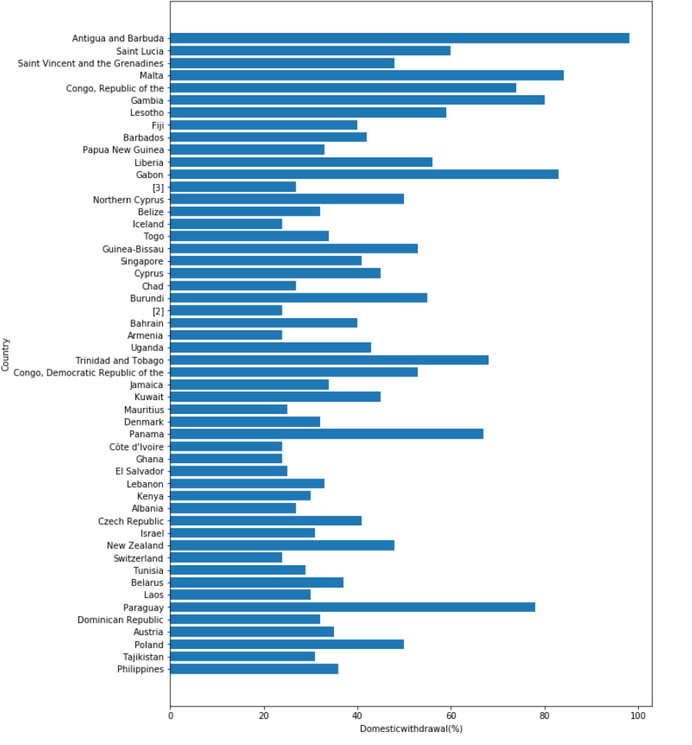
Domestic withdrawals Analysis
The top 5 countries in term of Domestic withdrawals of water are
Paraguay
Laos
New Zealand
Philippines
Togo

Slide 18
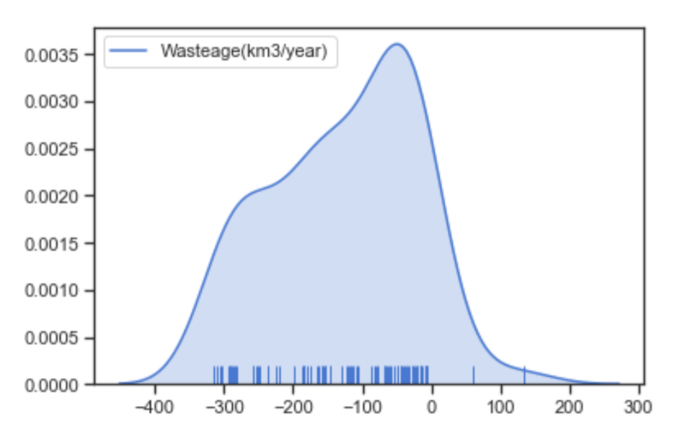
Wastage of water
The top 5 countries in term of wastage of water are:
China
India
Congo
Gambia
Lesotho
Confidence Interval
Upper:-281.89299926172305
Lower:-355.09995788113383

Slide 19
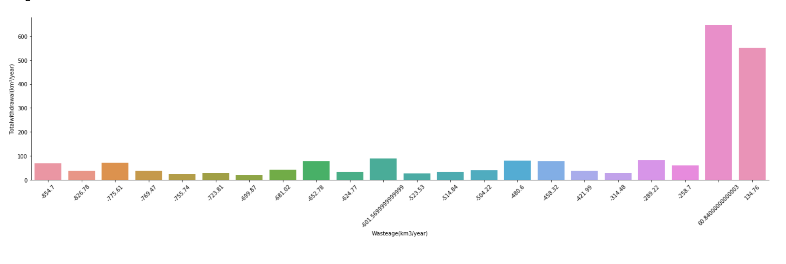
Wastage Vs Total Analysis
Bivariate analysis using wastage and total:
Some country with the more groundwater has most wastage.
Highest value with Total(549.76) and Wastage(134.76) .
Some don’t have the water to waste(Use).

Slide 20
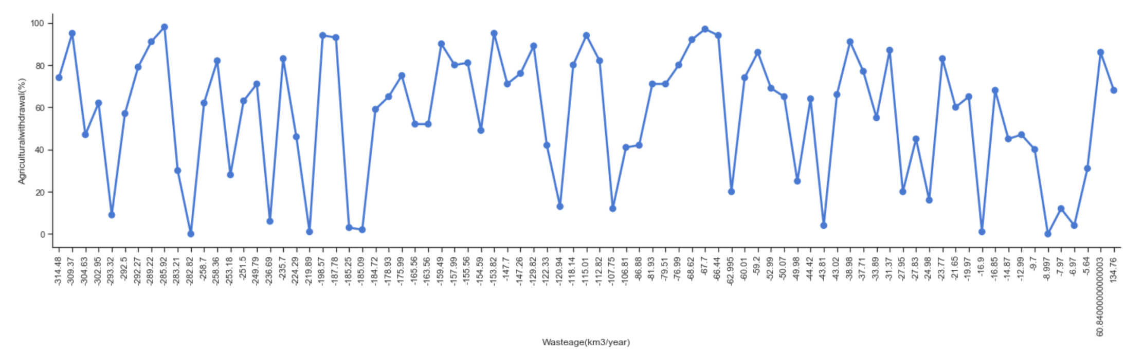
Wastage Vs Agriculture
The analysis between the wastage and the Agriculture
By this analysis we can say that Most of the countries withdrawal the water resources for the agricultural use only
It is estimated that 70% of world-wide water used for irrigation in agriculture.

Slide 21
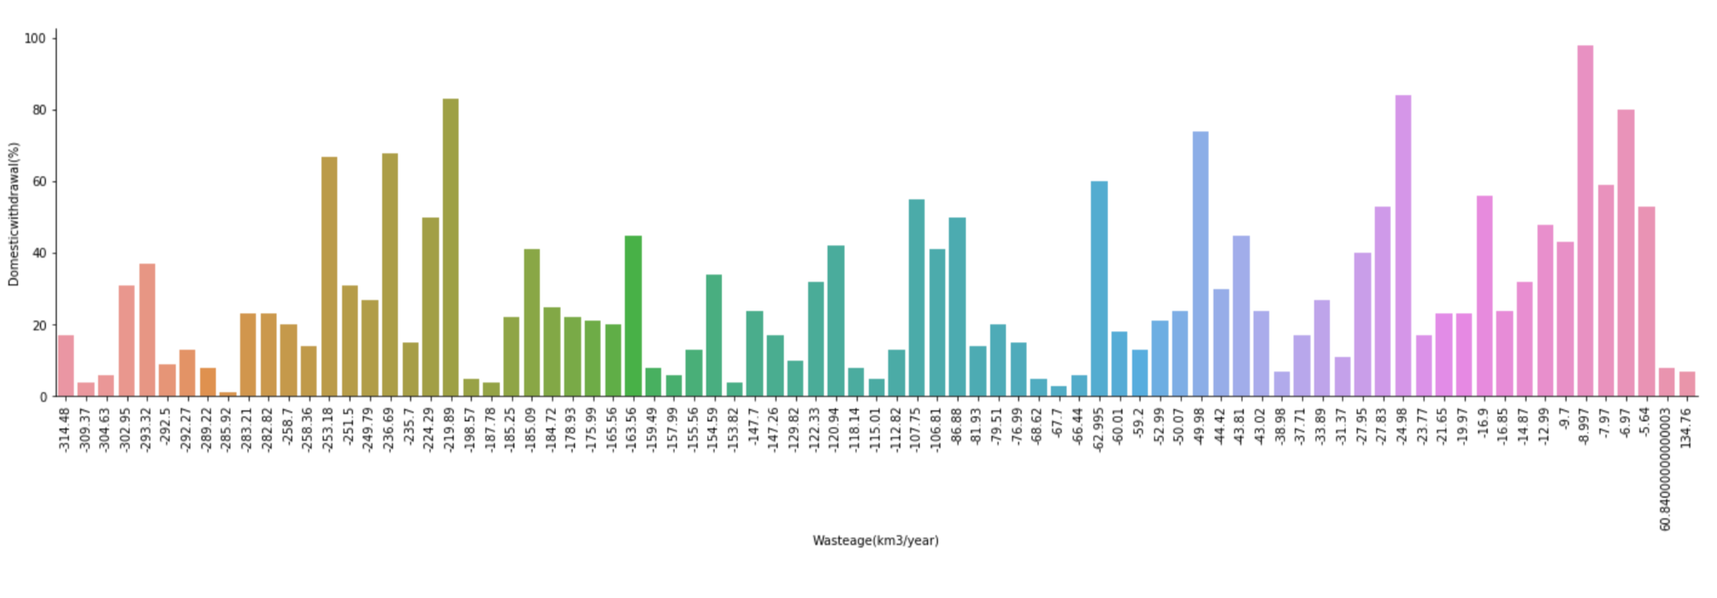
Wastage Vs Domestic
By this analysis we can estimate that most of part comes under the water-scarce areas
Demand exceeds the supply

Slide 22
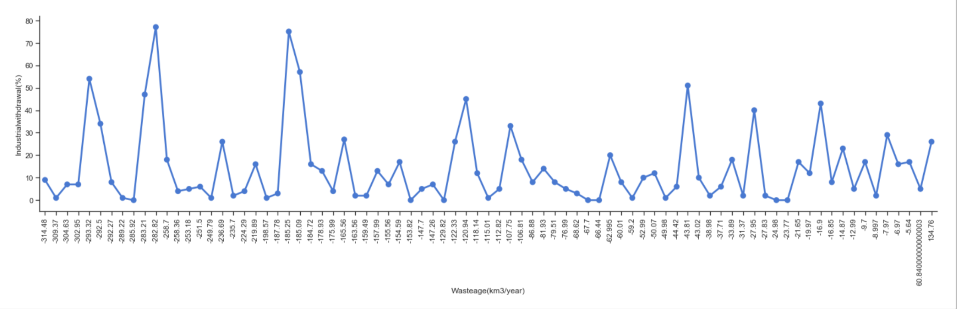
Wastage Vs Industrial
In this analysis we can estimate that the countries with more Industrial withdrawal have using most of there water resources for the industrial developments

Slide 23
Conclusion
Based on above analysis we can conclude that
The water deficient countries which are using their limited water resources efficiently are excelling in the agriculture and irrigation domains.
If the high water-consuming countries could provide some help to these countries in terms of sharing those resources, then it will contribute to a larger growth of those poor countries.
The food and clothing imported by wealthy Western countries are making it harder for many poor and marginalised communities to get a daily clean water supply as high-income countries buy products with considerable 'water footprints' - the amount of water used in production from water-scarce countries.

Slide 24
Thank you...

